Slide 1


Exploring Soils and
Educating Students
Presented by:
Linda Pettit and Amy Tressler
Environmental Educators
Franklin Soil and Water Conservation District
Ohio Certified Volunteer Naturalist Program
Non-OSU Logo

Slide 2
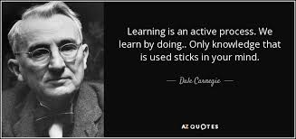
Notes:
This is why hands-on activities and interactive education are so important!

Slide 3
Ohio Earth Science Standards:
6th grade Soil Studies
Texture, Ingredients and Layers
8th grade Exploring Erosion
Movement of soil by wind, water or ice
Notes:
Current curriculum standards for science: Grade 3: introduction to soils, Grade 4: introduction to erosion, Grade 6: more in depth soil studies, Grade 8: weathering, erosion, deposition, topography and land forms

Slide 4

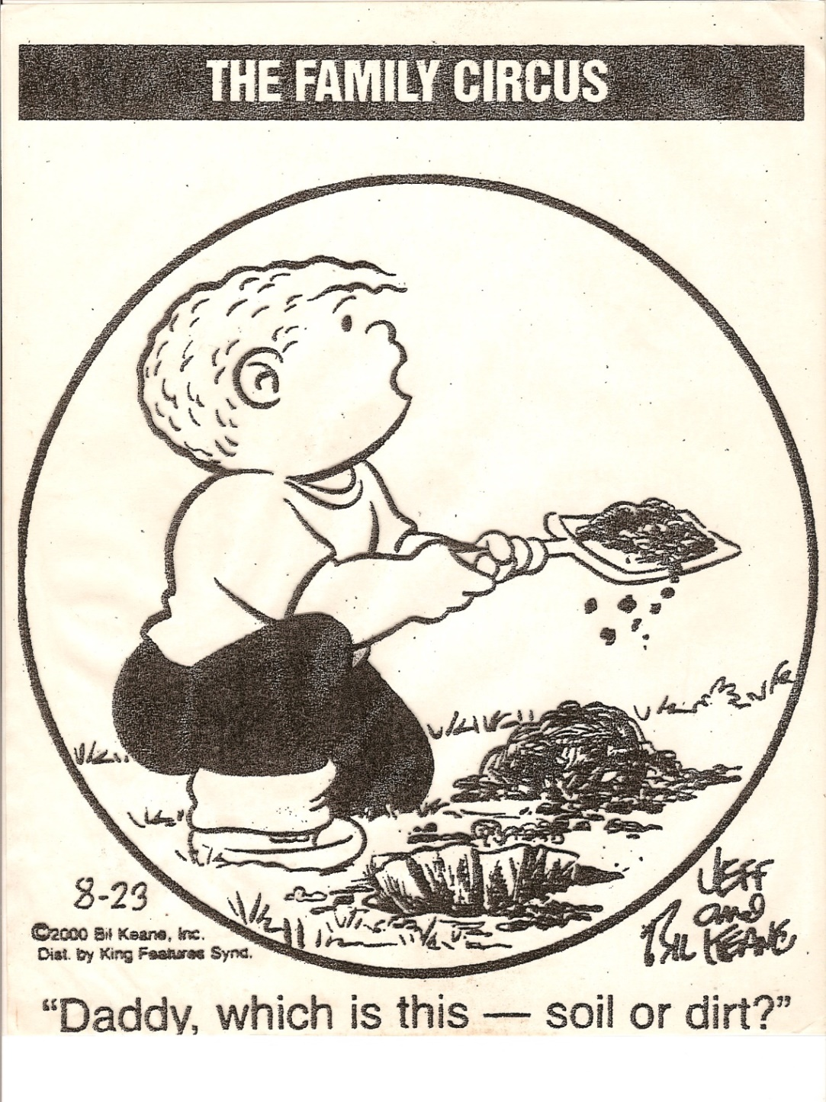
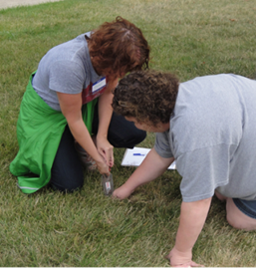
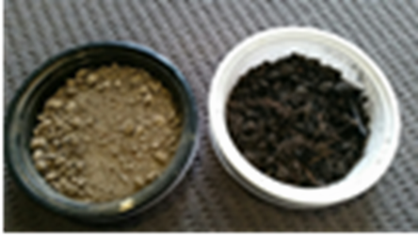
Notes:
Soil is the top covering of our earth where our plants grow, soil is where it is not supposed to be and usually causing a problem there (erosion, dirt on the carpet, etc.)

Slide 5
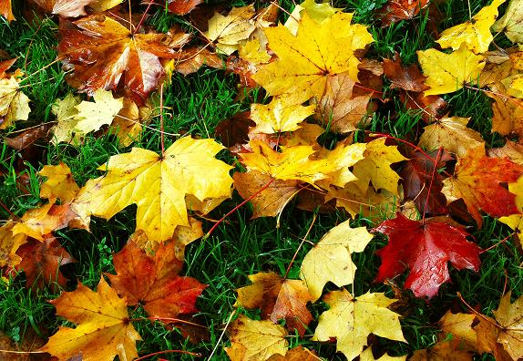
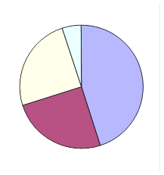
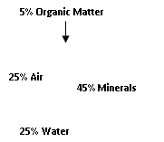
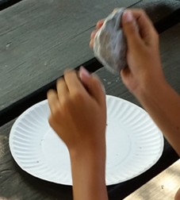
How is Soil Formed?
Notes:
Soil is made of ground up (weathered) rocks, organic material (dead plant material, compost, etc.), water and air

Slide 6
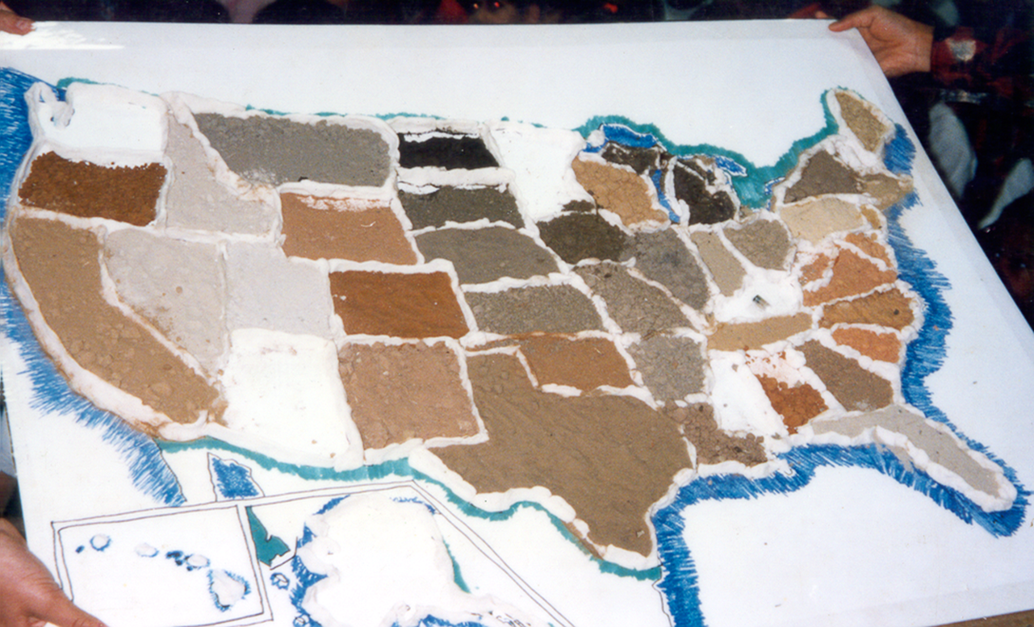
Are all Soils the Same?
Notes:
Soils vary in color from due to their parent rocks

Slide 7
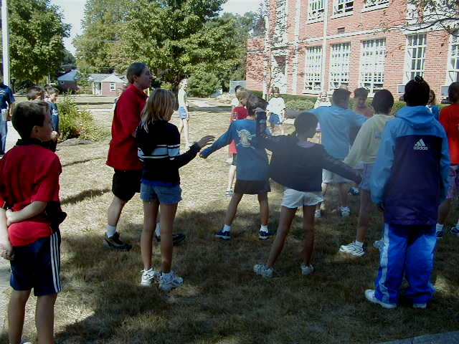
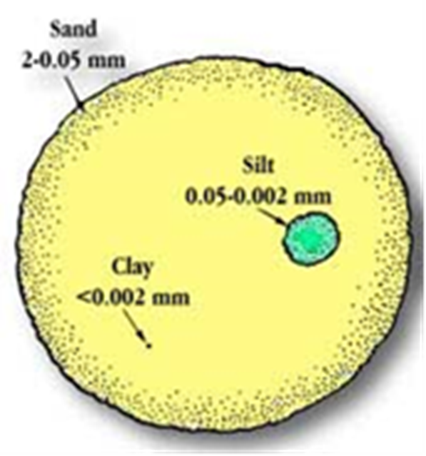
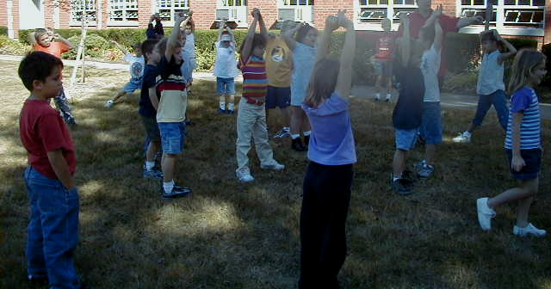
Introducing Sand, Silt and Clay
Demonstrating water movement through sand, silt and clay
Notes:
Sand, silt and clay are our 3 basic soil types. They each have a different texture or feel and as a result are useful for different things. This texture is due to the size of the grains. Sand is the largest particle size: imagine standing far enough apart that you cannot touch others with your arms out straight. This causes large gaps that water could flow through easily. Sand grains are large and round, so do not pack together well. Silt is a bit smaller – imagine standing with your hands on your hips – elbow to elbow. Water can flow through silt pretty well. Clay particles are flat and stack really well together. In the activity that is standing shoulder to shoulder. Water has a very hard time flowing through clay.

Slide 8
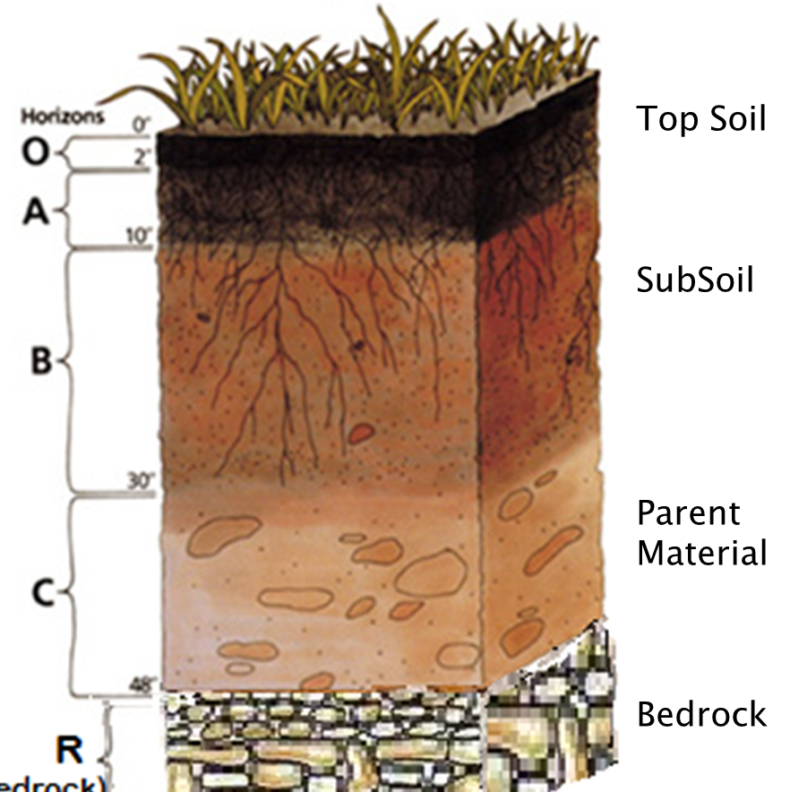

Notes:
O stands for organic matter, humus, dead plant material adding nutrients to the soil. The top soil is this whole first layer – darker due to the organic material and best for plants to grow in (Horizon A) The subsoil is lighter in color because it does not have the organic material. (Horizon B) The parent material is the layer where some soil is being formed from the rocks that break off from the bedrock on the bottom. This can happen from movement within the earth, freezing and thawing, etc. (Horizon C) Bedrock is the rock layer that is the support system for the soil. (Horizon R – for rock)

Slide 9
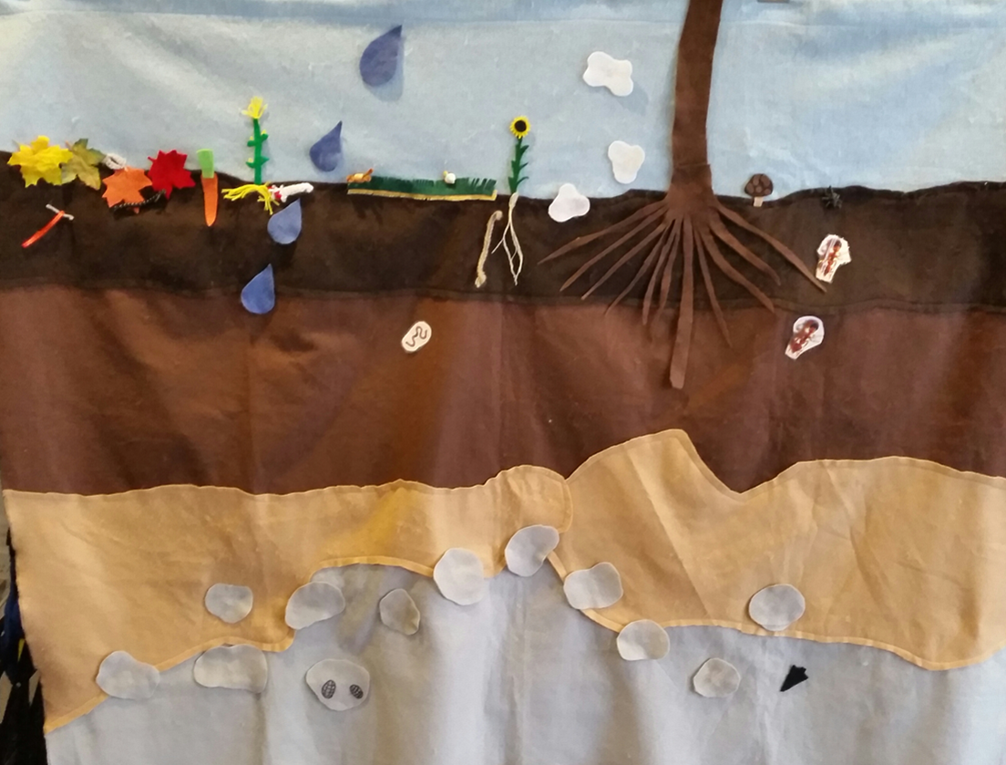
Interactive Soil Activities
Felt provides an adaptive setting to explore what lives in and makes up soil.

Slide 10

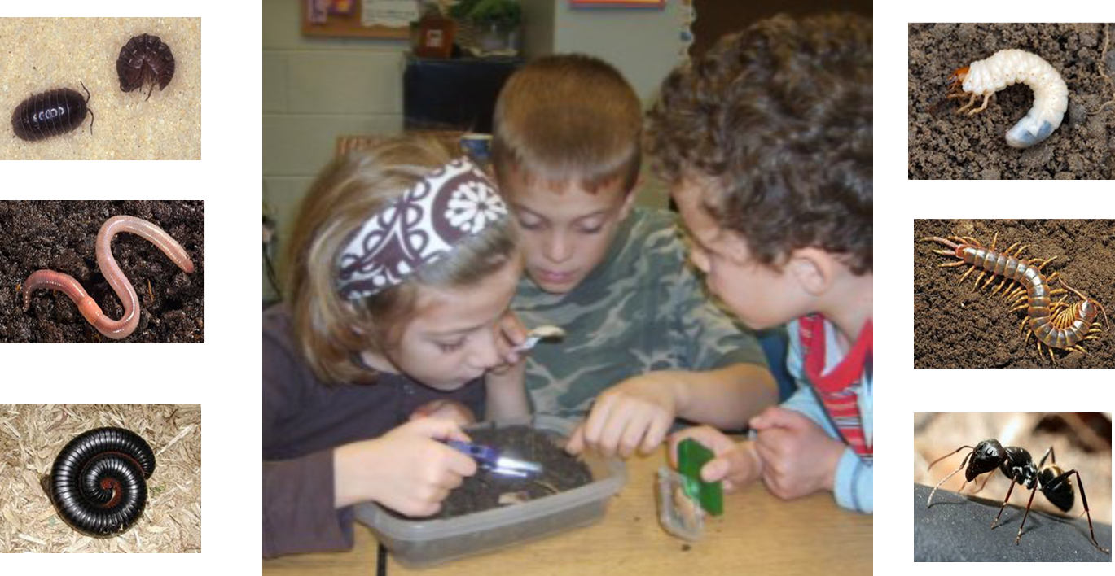


Slide 11
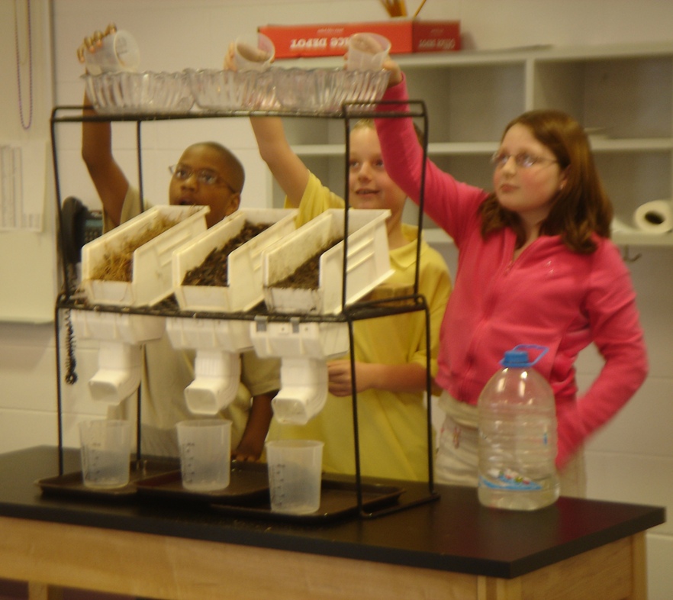
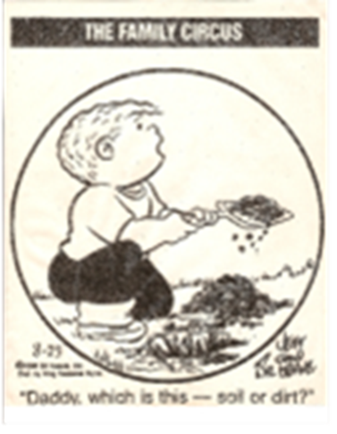
Exploring Soil Erosion
Notes:
This experiment demonstrates the power of water on bare soil and the protective covering mulch and grass produce. This is a visual representation of erosion. Students are encouraged to make predictions before the experiment and conclusions following.

Slide 12


Slide 13

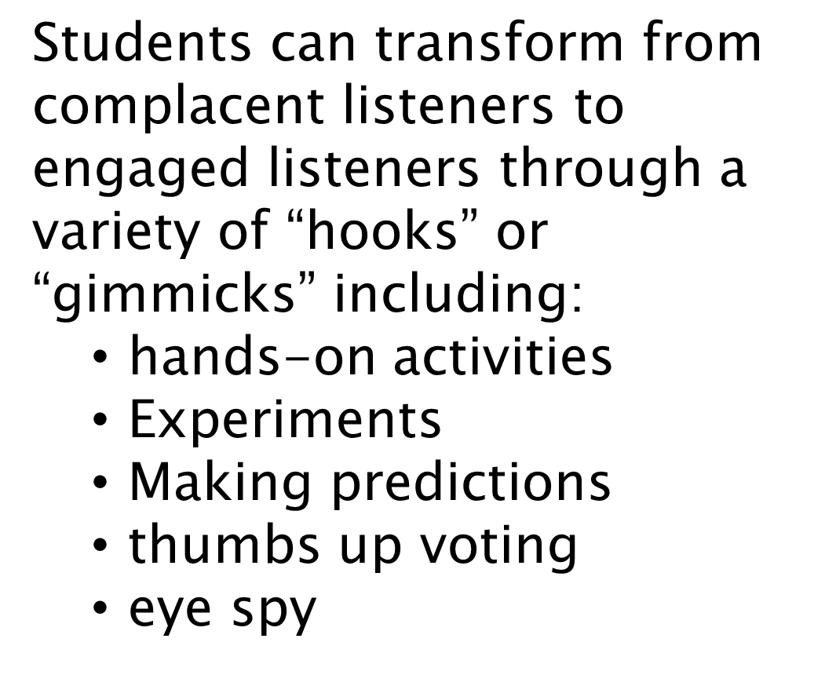

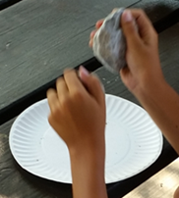


Slide 14
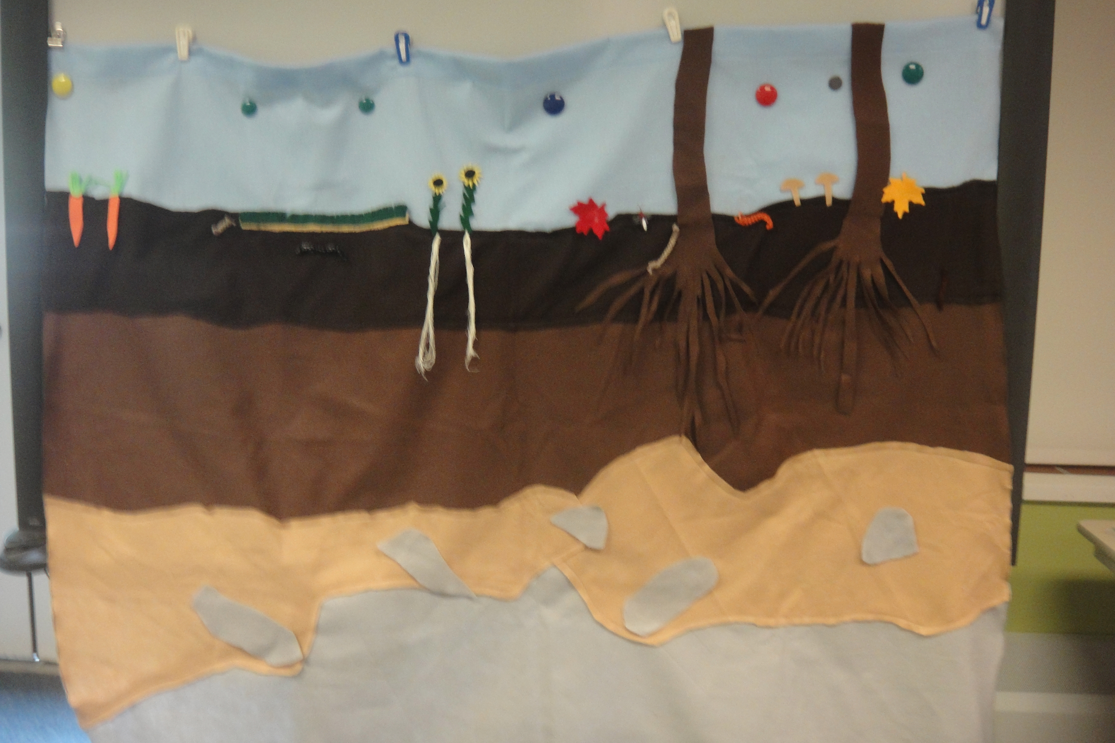
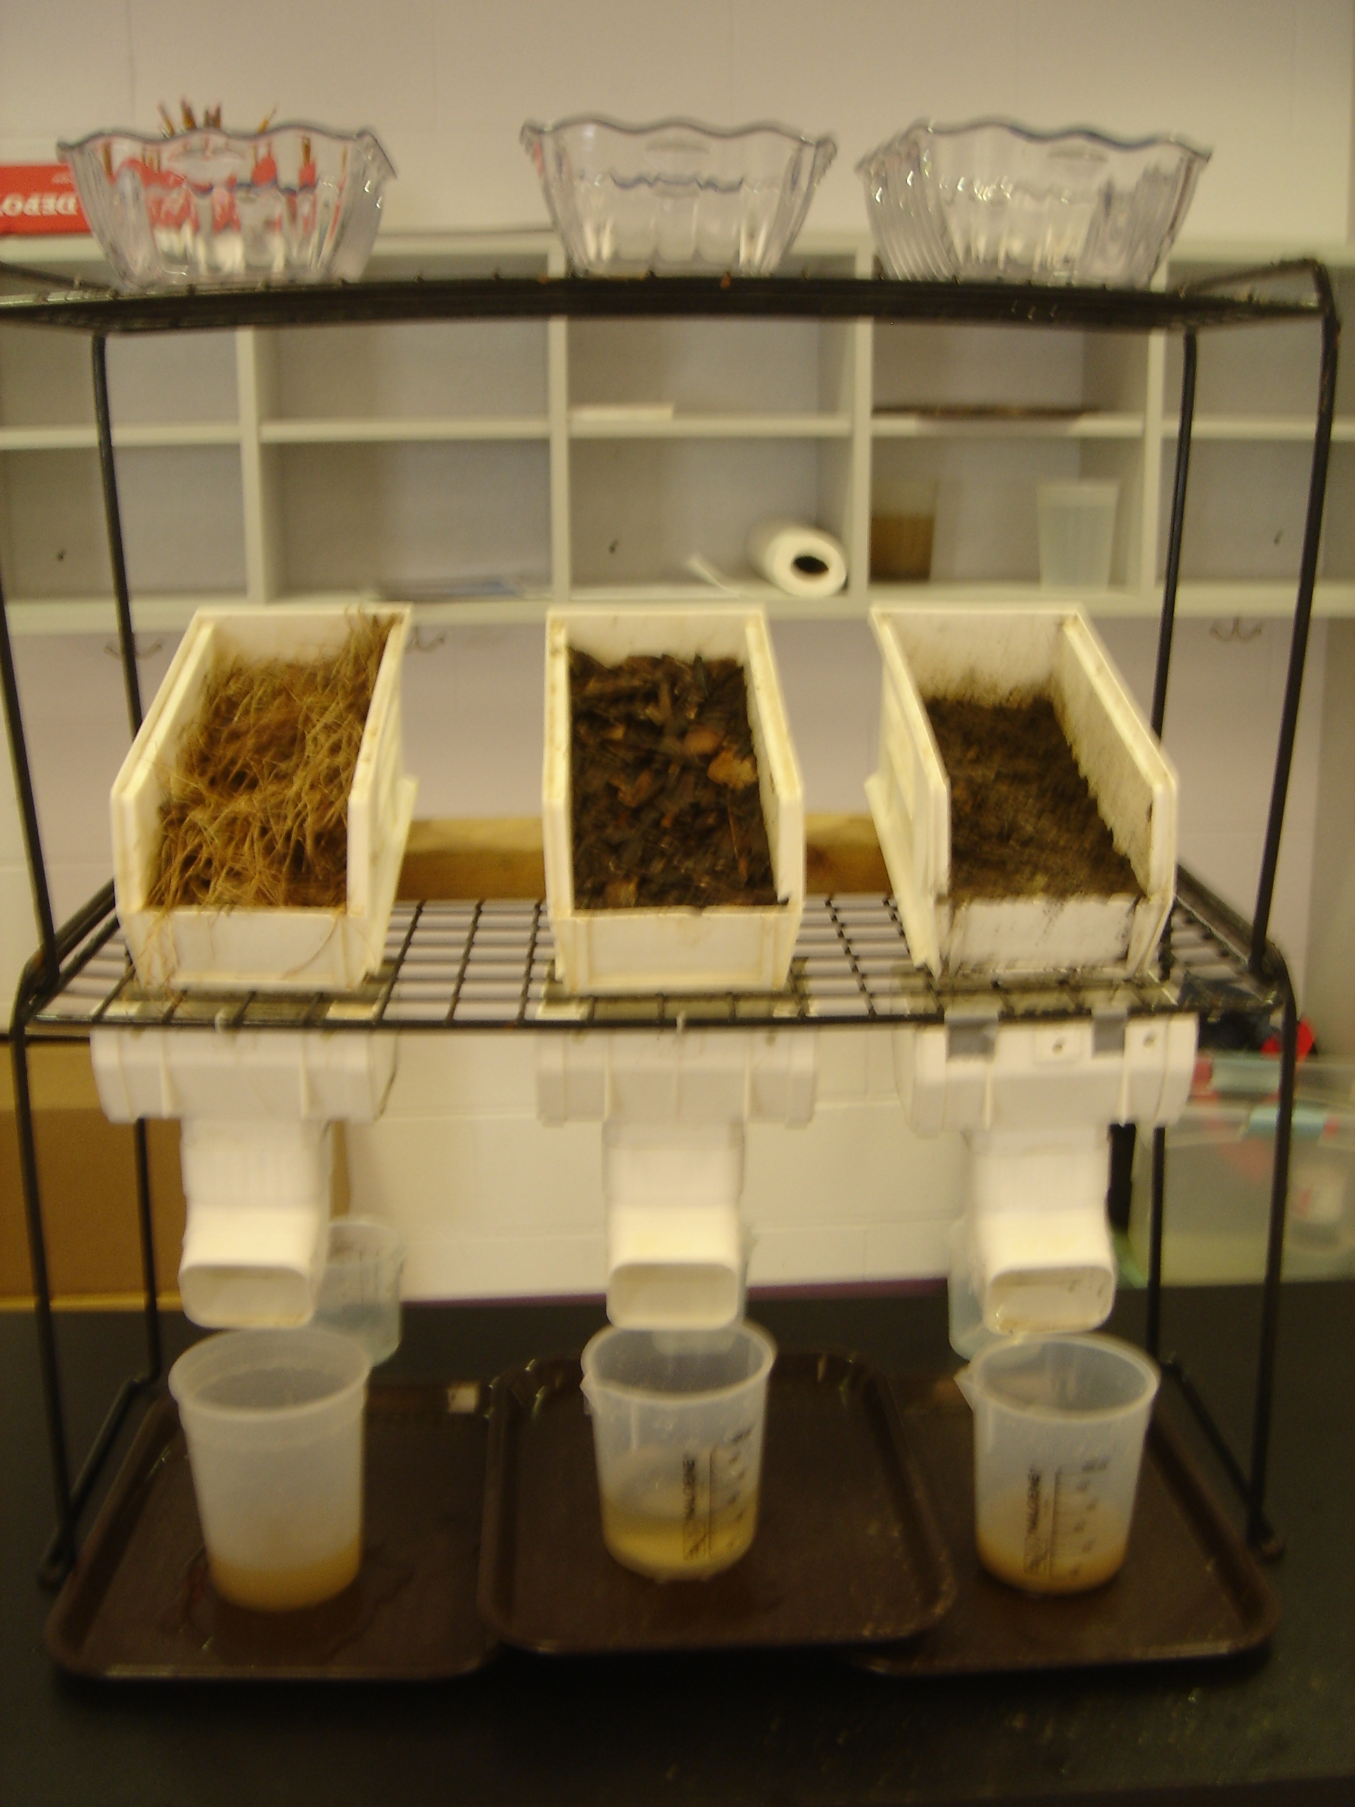
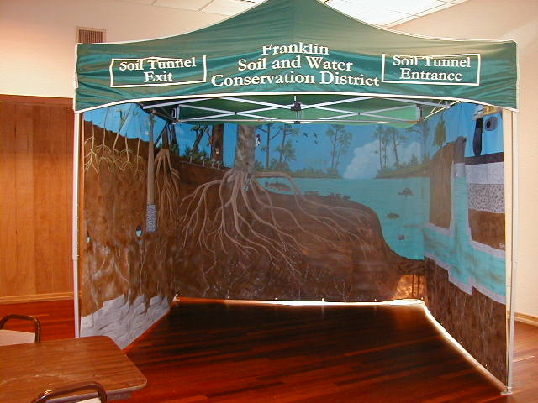
Loan Kits available from
Franklin Soil and Water Conservation District
Soil | Model or Kit Description | Correlation to Standards
Soil Profile Panel | This hanging felt board tells the story of soil below the surface including different soil types, soil layers, plant roots, and animals that live underground. The kit includes felt parent material, arrow heads, plant roots and “critters” for the students to add to this underground view. Plant growth and plant parts can also be explored with this model. | Earth and Space Sciences: preK, 3, 4, 6, 8 Life Sciences: 1, 2, 4, 5
Soil Erosion Simulator | The concept of erosion is demonstrated with the soil erosion simulator. Students can predict and compare the effects of rain falling on bare soil, mulched soil and grass. Students can also test different theories involving soil erosion, water quality, landscape alterations and the differences between permeable and impermeable surfaces with this model. | Earth and Space Sciences: 3, 4, 8 Life Sciences: 3, 4 H.S. Environmental Science
Rocks and Soil Loan Kit | This kit includes background information, hands-on activities, children’s literature, rock, fossil and soil samples and reference materials to help meet the Earth and Space Sciences learning standards covering the properties, types and importance of rocks, minerals, fossils and soil. | Earth and Space Sciences: preK, 3, 4, 6 Life Sciences: 4

Slide 15
Exploring Activities Related to Soils
Project Learning Tree
Soil Stories
Utah Agriculture in the Classroom –
Dirt: Secrets in the Soil
What’s In Soil
Keeping Soil in its Place
Project WET
Just Passing Through
Nutrients for Life –
From the Ground Up: The Science of Soil
Properties of Soil
Project WILD –
Growing Up Wild
Wiggling Worms
Project Food Land and People
Perc Through the Pores

Slide 16
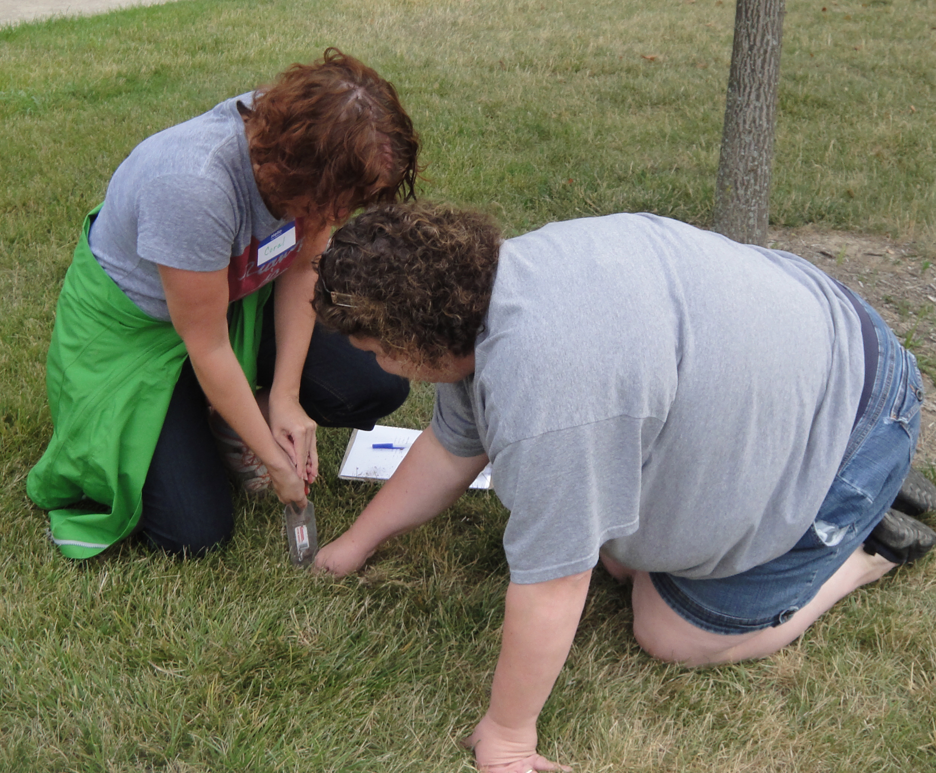
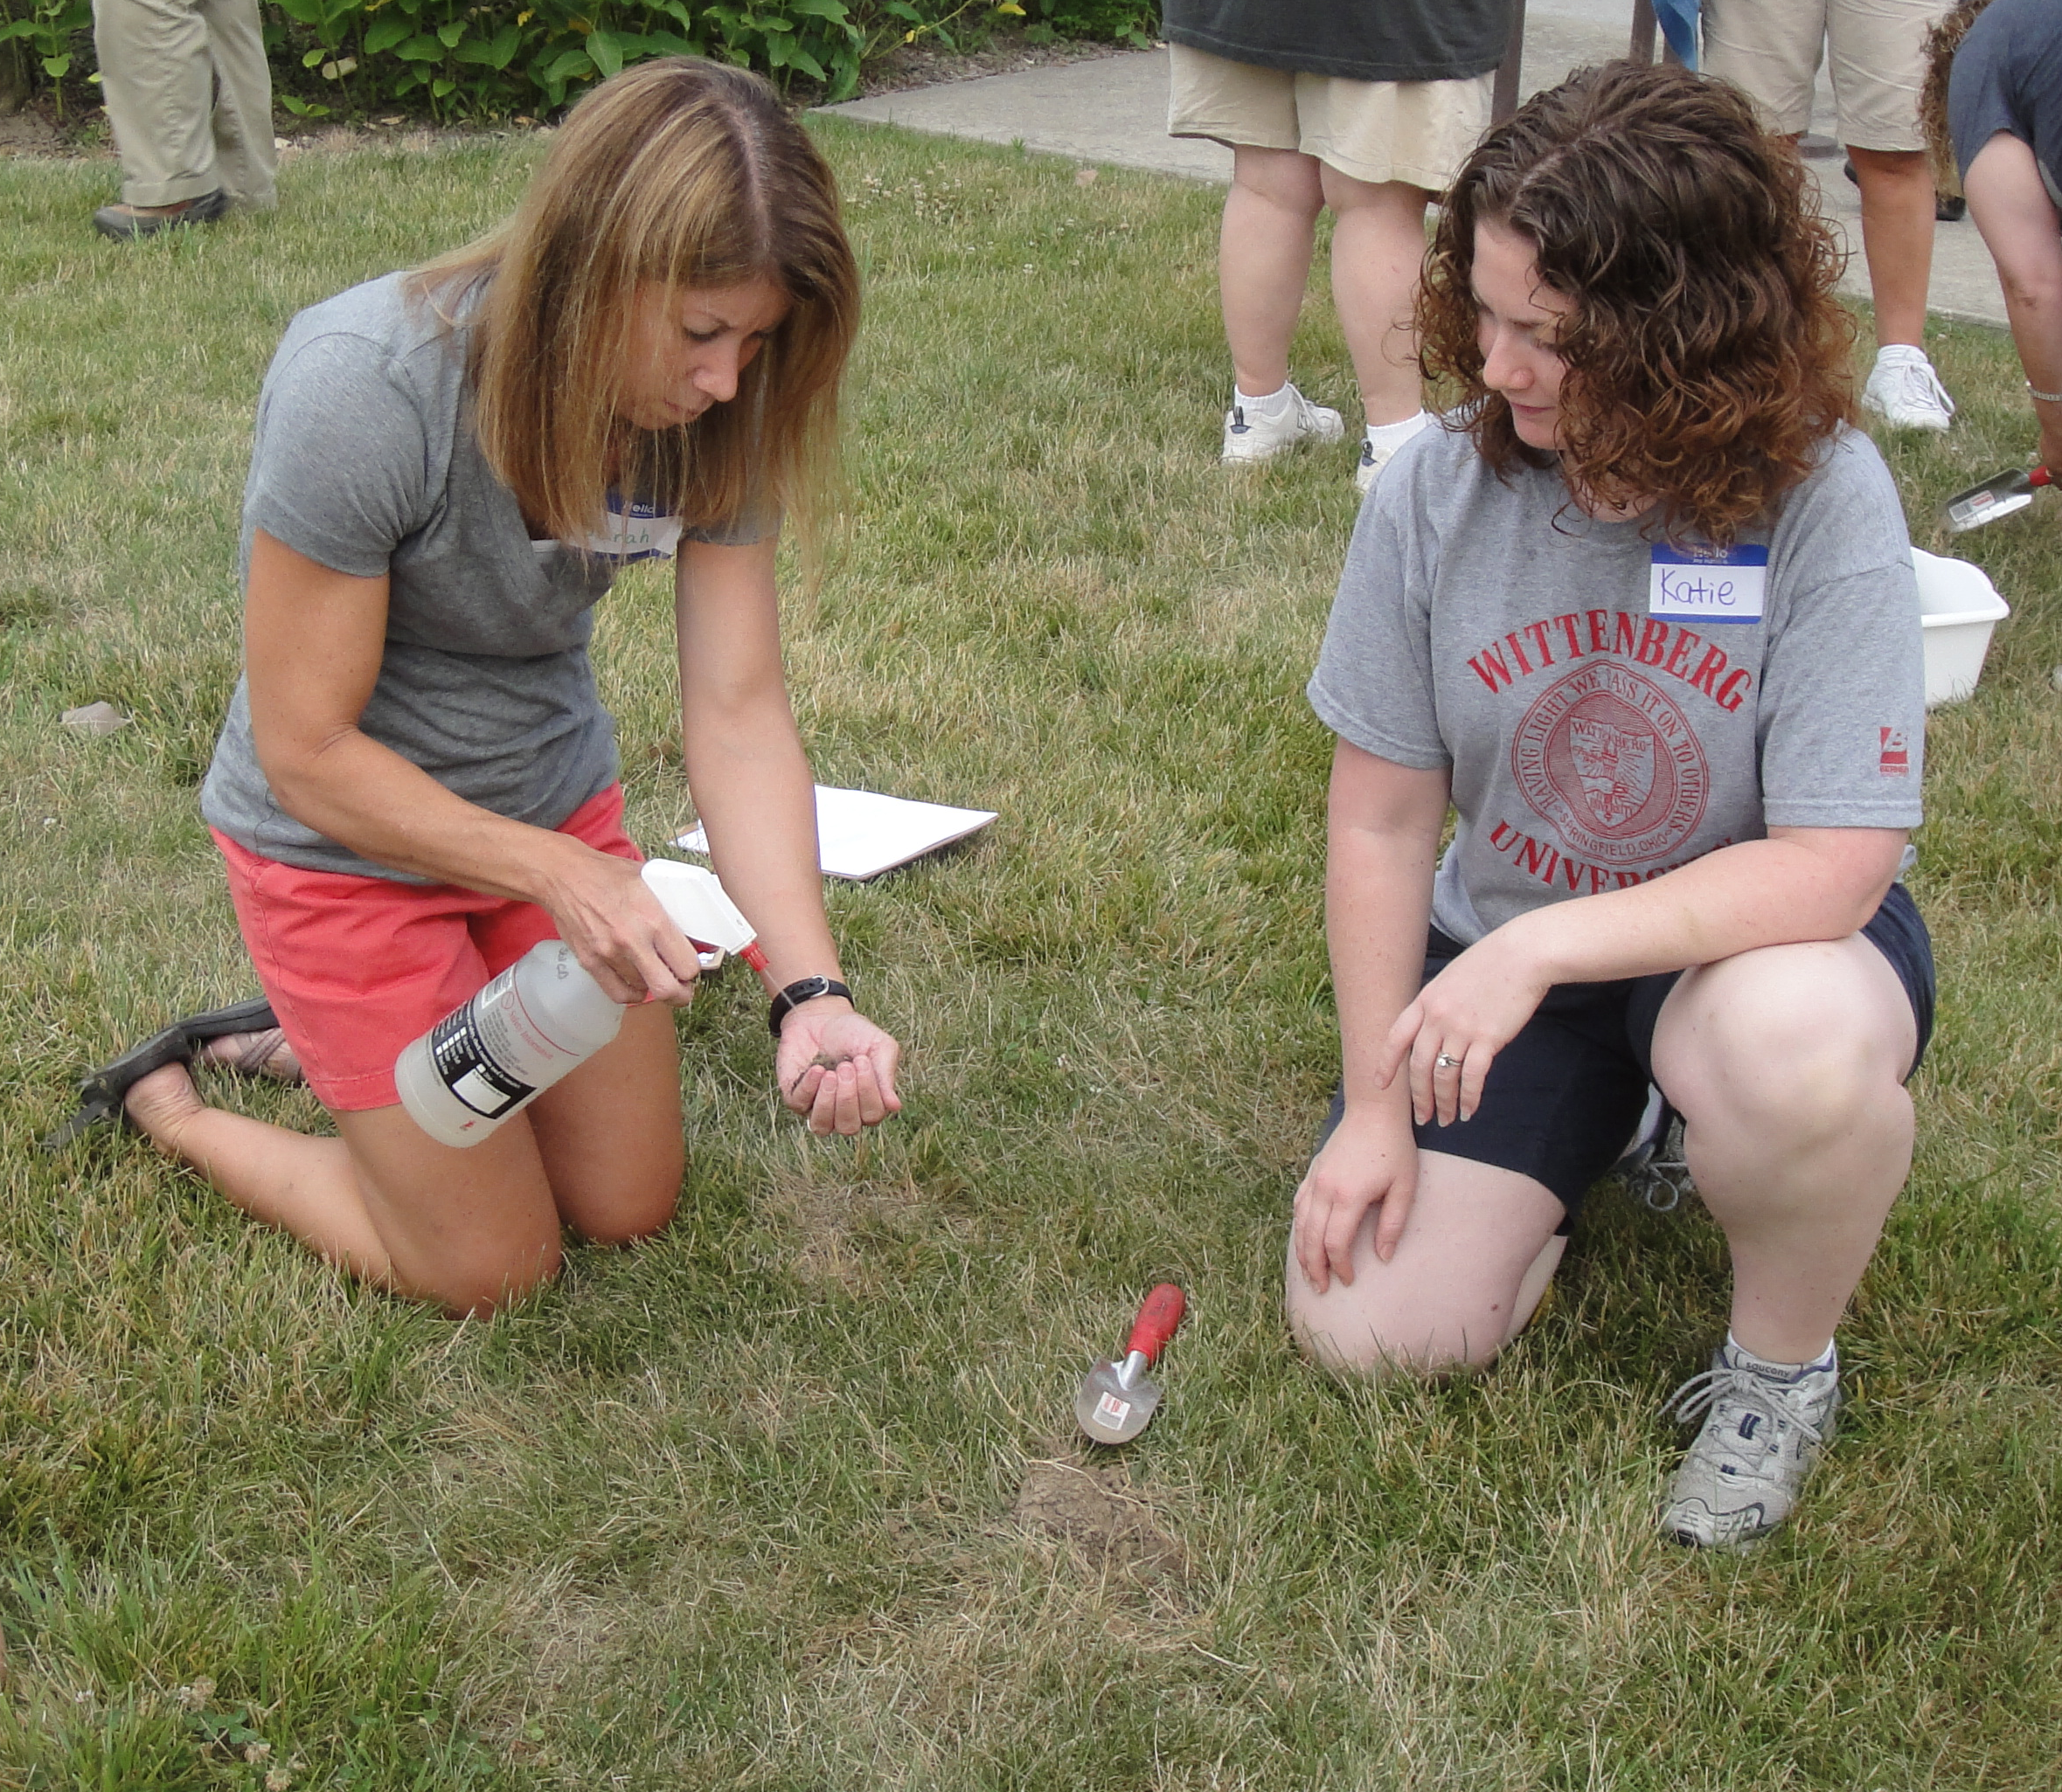

Utah Ag in the Classroom
Activities and You Tube videos exploring the texture, porosity and importance of soil, as well as the causes and problems of erosion.
An interactive project in cooperation with Utah State University Extension and the Utah Foundation for Agriculture in the Classroom.
https://utah.agclassroom.org
Dirt: Secrets in the Soil https://utah.agclassroom.org/workshops/21eat_dirt.cfm

Slide 17
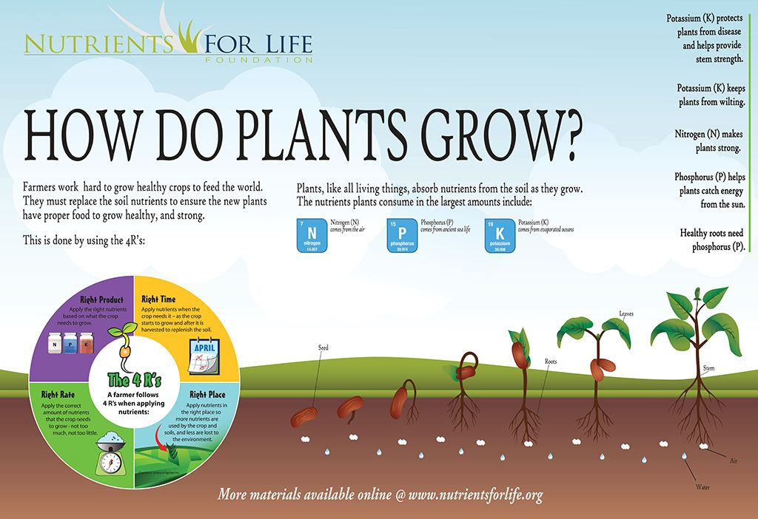

Nutrients for Life
Free downloadable lessons, videos, posters and resources about soil and nutrient components needed to feed a growing population.
The Nutrients for Life Foundation is a global organization that develops and distributes science-based materials to improve plant nutrient literacy, soil health knowledge and promotes fertilizer’s role in sustaining a growing population.
https://nutrientsforlife.org/for-teachers/educator-resources /
Ground Up: The Science of Soil
These 6 free interactive lesson plans, videos, and classroom tools promote a deeper understanding of core science concepts as your students discover the complex world of soil. This hidden ecosystem not only supports food production but nearly every form of life on Earth!
https://nutrientsforlife.org/product/from-the-ground-up-the-science-of-soil/

Slide 18
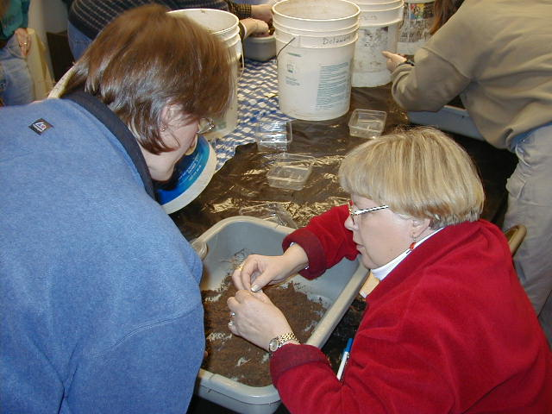
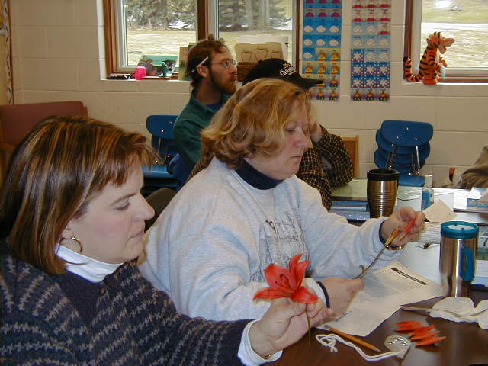

Project Food, Land and People
FLP envisions a future in which all people recognize the interdependence of agriculture, the environment and human needs . . .
FLP promotes agricultural and environmental awareness, critical thinking and problem solving skills, cooperative attitudes and appreciation for cultural differences.
https://www.foodlandpeople.org
Garden Wise: Educating With a Garden www.foodlandpeople.org/ordering/gardenwise/

Slide 19
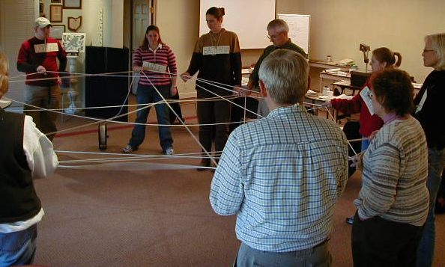
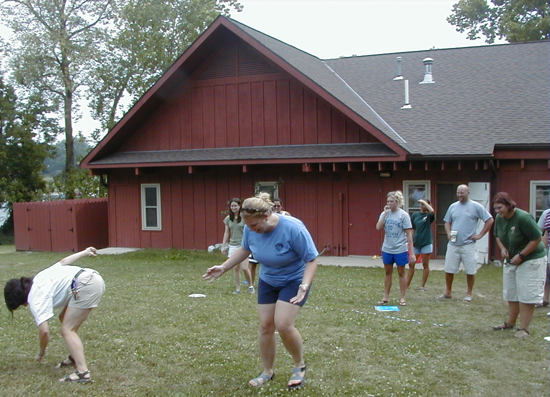



Project Learning Tree
PLT uses the forest as a “Window on the World” to increase students understanding of our complex environment. It is not just about trees! I’s about the total environment: land, air and water. It is local, national and global in scope.
PLT is activity based and can be applied to both formal and non-formal settings.
PLT Ohio is sponsored by ODNR Division of Forestry and coordinated by Sue Wintering.
https://www.plt.org/network/ohio
www.plt.org

Slide 20
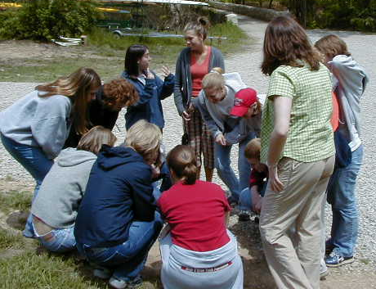
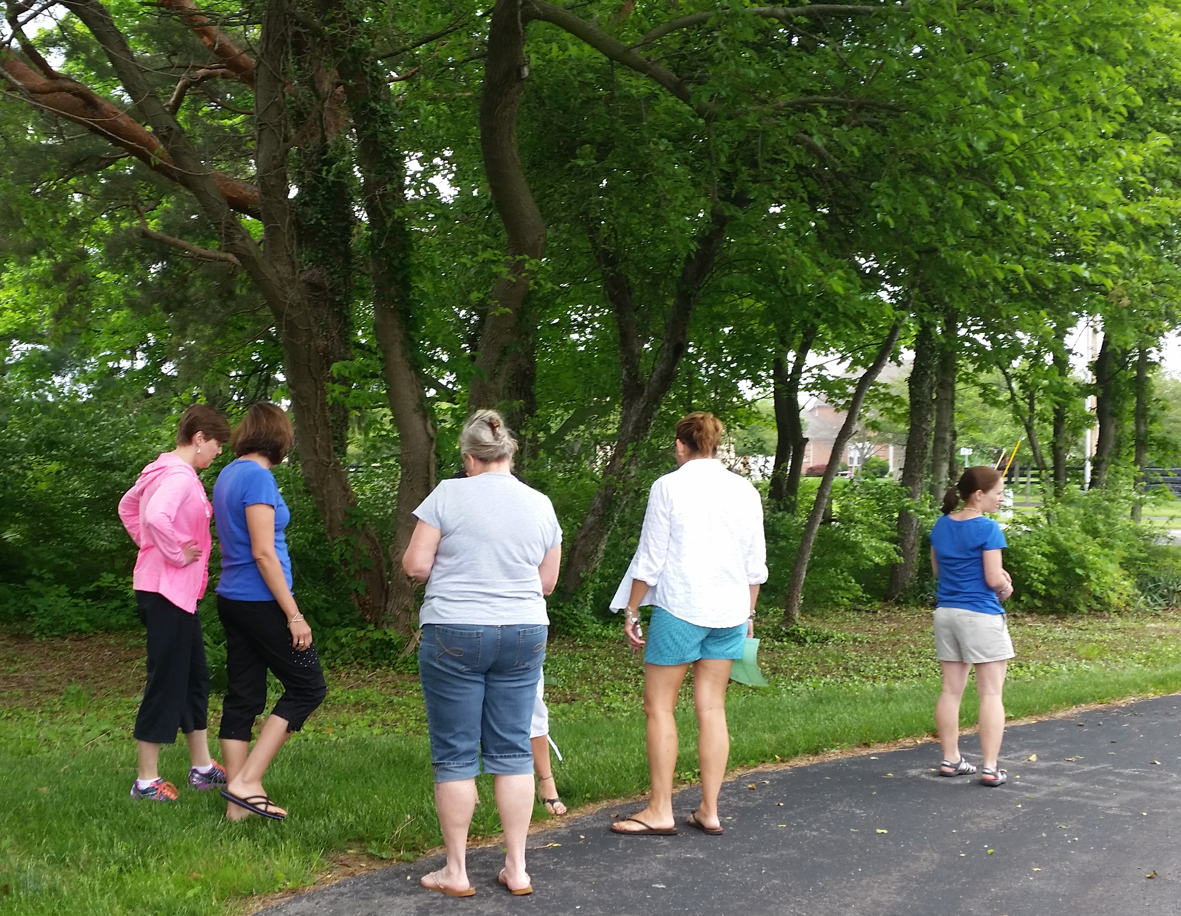



Project WILD
Project WILD is a supplementary education program emphasizing awareness, appreciation, and understanding of wildlife, natural resources and the environment.
Students in preK – twelfth grade learn these concepts through hands-on, diverse activities.
Sponsored in Ohio by ODNR-Division of Wildlife. Coordinated by Jen Dennison.
http://wildlife.ohiodnr.gov/education-and-outdoor-discovery/conservation-education-project-wild
www.projectwild.org

Slide 21
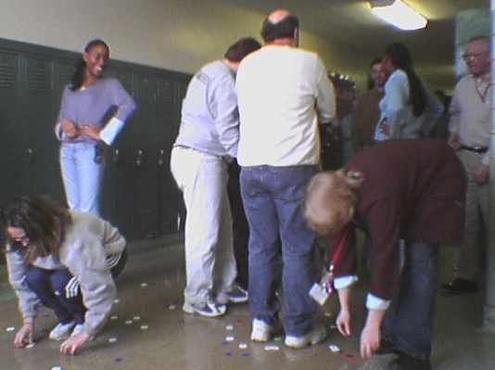
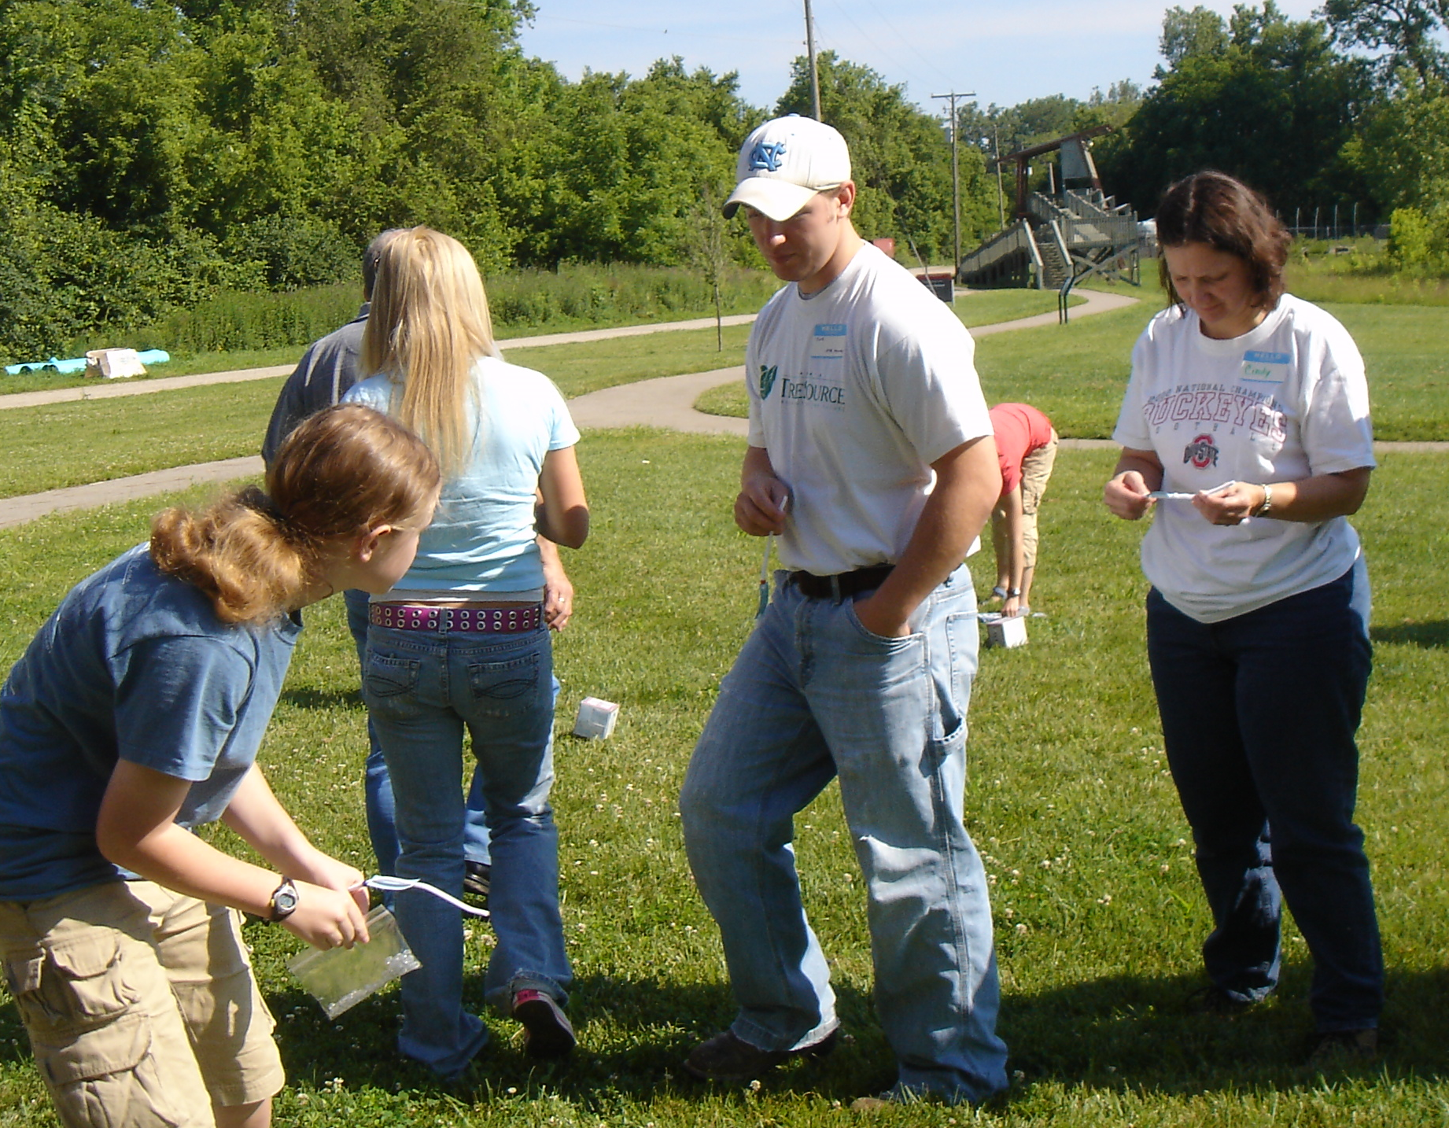


Project WET:
Water Education for Teachers
Project WET is an international, interdisciplinary, water education program for formal and non-formal educators of students K-12.
The curriculum is a series of hands-on activities designed to help students move from awareness to changes in lifestyles while building understanding of our water resources.
Project WET in Ohio is coordinated by Dennis Clement at OhioEPA/OEE.
http://epa.ohio.gov/oeef/ProjectWET.aspx
www.projectwet.org

Slide 22


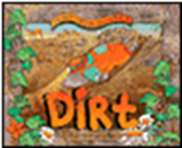
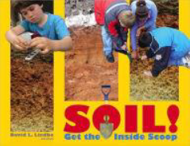
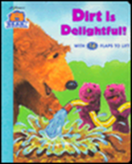



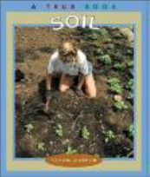

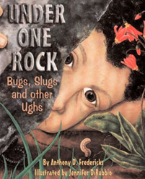



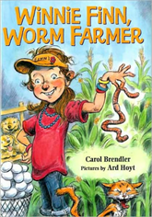
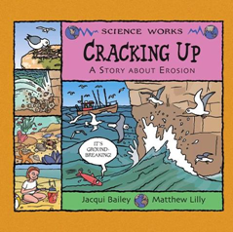

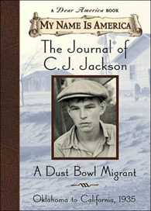




Enhancing Science Through Stories

Slide 23


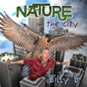
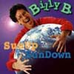
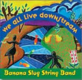

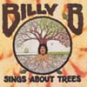
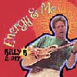
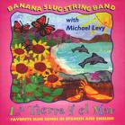
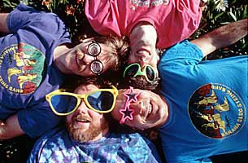


Enhancing Science With Music
“Billy B” Brennan
Banana Slug String Band

Slide 24
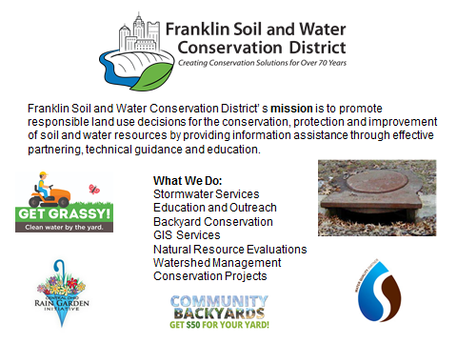

Slide 25

For more information contact:
Linda Pettit and Amy Tressler
Environmental Educators
Franklin Soil and Water Conservation District
1404 Goodale Boulevard, Suite 100
Columbus, OH 43212
www.franklinswcd.org
lpettit@franklinswcd.org
atressler@franklinswcd.org

